Slide 1

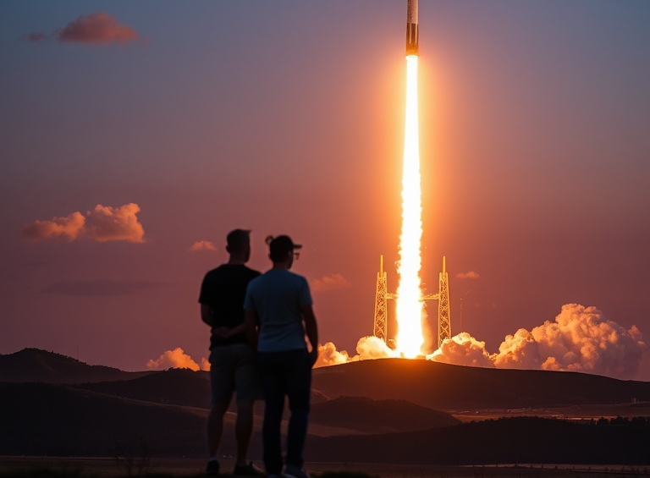
SPACEX IBM Data Science Project
Sion Pritchard
September 2025

Slide 2
Outline
Executive Summary
Introduction
Methodology
Results
Conclusion

Slide 3

Executive Summary
In this project, a rival company to SpaceX wants to use SpaceX’s rocket launch to determine the first stage landing success rate and cost of rocket launches.
Summary of methodologies:
Data collection. Data wrangling. Exploratory data analysis with data visualisation and SQL.
Building an interactive map with Folium. Building a dashboard with Plotly. Predictive Analysis: Classification
Key insights: Launch site, payload mass, and orbit type significantly impact landing success. NASA (CRS) missions carried the highest cumulative payloads. Certain landing outcomes strongly correlate with booster reuse
Impact: Provides data-driven evidence for SpaceX’s cost-reduction strategies. Predictive model achieved strong accuracy, aiding in forecasting mission success.

Slide 4


Introduction
This capstone project is part of the IBM Data Science Professional Certificate, the aim is to showcase data science and machine learning techniques using real-world data and to summarise the end-to-end process in a report.
In this project, a rival company to SpaceX uses SpaceX Falcon 9 rocket data to determine the rocket first-stage landing successes and to determine the cost of a launch. SpaceX advertises Falcon 9 rocket launch cost to be 62 million USD. Whereas for other companies the cost of a rocket launch can exceed 150 million USD.
Jupyter Notebook worksheets are used to perform data collection and analysis tasks in this project, these worksheets are available to see in my GitHub “IBM Data Science” repository.
The major parts of this report include data collection methodology, data wrangling, exploratory data analysis (EDA), interactive data visualization, machine learning (ML) classification model development, and model evaluation. Finally, the accuracy of different ML algorithms are compared in predicting the future landing of the Falcon 9 first stage rocket.

Slide 5
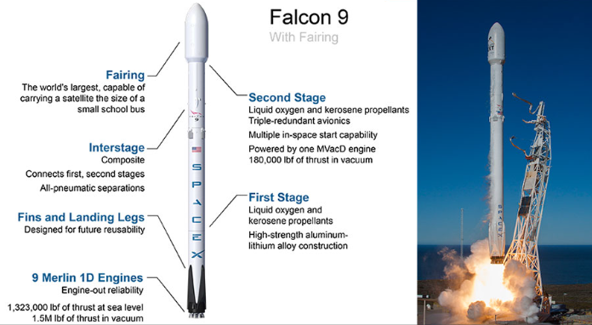

methodology

Slide 6
Methodology
Data for this project was sourced from the SpaceX REST API and the Wikipedia launch table. The dataset underwent comprehensive preprocessing, including data cleaning, feature engineering, and formatting for both visualisation and input into machine learning models such as logistic regression, support vector machines (SVM), decision trees, and K-Nearest Neighbours (KNN).
Exploratory Data Analysis (EDA) was conducted using SQL queries and Python-based visualisations to uncover patterns and insights. Interactive data visualisations were developed using Plotly Dash and Folium, enabling dynamic geospatial and analytical representation of the launch data.
Predictive modelling was performed to classify the likelihood of a successful first-stage landing of the Falcon 9 rocket, with model performance evaluated using accuracy metrics in sci-kit learn.

Slide 7
Data Collection
Data collection and visualisation steps:
Collect data from SpaceX API and convert it to a .JSON file
Scrap and filter data to include Falcon 9 data, then assign that data to the dataframe and export it to a .csv file.
Plot and visualise the data.
Data collection Lab: IBM-Data-Science/Course-10-Capstone-Project/jupyter-labs-spacex-data-collection-api.ipynb at main · Sion719/IBM-Data-Science

Slide 8

Web scraping
To webscrape SpaceX’s Wikipedia page, a HTTP GET method was performed to request the Falcon9 launch HTML page, then a BeautifulSoup object was created by the HTML response.
BeautifulSoup was then used to find all tables within the Wikipedia page.
By parsing the launch HTML tables, a dataframe was created.
GitHub link: IBM-Data-Science/Course-10-Capstone-Project/jupyter-labs-webscraping.ipynb at main · Sion719/IBM-Data-Science

Slide 9
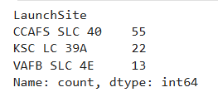
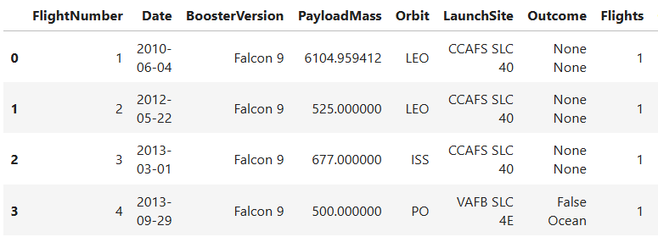
Data wrangling
Firstly, the number of launches on each site was calculated, then the number and occurrence of each orbit was counted so that we could determine the number of landing outcomes. This means we can now assign a binary variable to distinguish the outcome of the rocket landings.
Data Wrangling Lab: IBM-Data-Science/Course-10-Capstone-Project/labs-jupyter-spacex-Data wrangling.ipynb at main · Sion719/IBM-Data-Science
Number of launches at each site
A sample of the SpaceX dataset

Slide 10
Exploratory Data analysis with data visualisation
Using scatterplots, the relationship between flight number and launch site was visualised, and so was the relationship between payload mass and launch site.
A bar chart was used to see if there is a relationship between the success rate and orbit type.
More scatterplots were used to visualise the relationship between flight number and orbit type, and between payload mass and orbit type.
A line chart was used to observe how the success rate developed year on year.
For consistency purposes all numeric columns were developed to float64 format.
EDA with Visualisation Lab: IBM-Data-Science/Course-10-Capstone-Project/jupyter-labs-eda-sql-coursera_sqllite.ipynb at main · Sion719/IBM-Data-Science
Matplotlib and Seaborn was used for visualisation

Slide 11

EDA with SQL
Display the names of the unique launch sites in the space mission
Display five records where launch sites begin with the string ‘CCA’
Display average payload mass carried by booster launched by NASA (CRS)
Display average payload mass carried by booster version F9 v1.1
List the date when the first successful landing outcome in ground pad was achieved
List the names of boosters which have success in drone ship and mass with an average payload mass between 4000 and 6000
List the total number of successful and failure mission outcomes
List the names of the boosters which carried the maximum payload mass
Rank the count of landing success outcomes
EDA lab: IBM-Data-Science/Course-10-Capstone-Project/jupyter-labs-eda-sql-coursera_sqllite.ipynb at main · Sion719/IBM-Data-Science

Slide 12
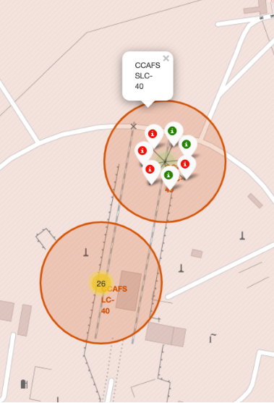
Build an interactive map with Folium
Folium was used to create an interactive map. The NASA Johnson Space Center in Houston, Texas was made as the center point, using Folium.circle to add a highlighted circle around the space center’s location.
A dataframe was created to classify successful and unsuccessful launches by colour (green, red). They were also added to the map, Folium clusters were created to show the location of the launches and identify the success rates of launch sites.
A mouse position was created to get location coordinates. A polyline was drawn from landing sites and the coastline to measure distance, this helps to easily answer questions such as “Are launch sites in close proximity to the coastline?”.
Folium Lab: IBM-Data-Science/Course-10-Capstone-Project/lab_jupyter_launch_site_location.ipynb at main · Sion719/IBM-Data-Science

Slide 13

Build a dashboard with Plotly
Step 1: Add a dropdown list to enable launch site selection
Step 2: Add a pie chart to show the total successful launch counts for all sites
Step 4: Add a scatter chart of payload mass vs. success rate of different booster versions
Step 3: Add a range slider to select the payload

Slide 14
Predictive Analysis (Classification)
Built a machine learning model to predict if the first stage will land so that we can determine the cost of a launch.
A NumPy array was created for the Class column, the data was then standardised and reassigned using a transform. The data was split into training and test sets.
A logistic regression object was created and a GridSearchCV object was created with a CV of 10. Using the score method, we calculated the accuracy of the test data and visualised it using a confusion matrix.
A support vector machine object and a GridSearchCV was created with a CV of 10. Using the score method, we calculated the accuracy of the test data and visualised it using a confusion matrix.

Slide 15
Predictive Analysis (Classification)
A decision tree classifier object and a GridSearchCV with a CV of 10 was created, the accuracy was calculated using the score method and a confusion matrix was used for interpretation.
A KNN object was created using a GridSearch CV with a CV of 10, the accuracy was calculated using the score method and interpreted using a Confusion matrix.
Each method was then evaluated in detail to discover which method was most effective.
ML Prediction Lab: IBM-Data-Science/Course-10-Capstone-Project/SpaceX_Machine Learning Prediction_Part_5.ipynb at main · Sion719/IBM-Data-Science

Slide 16
Results
Exploratory Data Analysis Results
Predictive Analysis Results

Slide 17
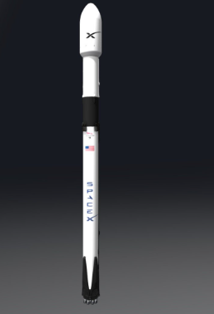
Insights drawn from EDA

Slide 18
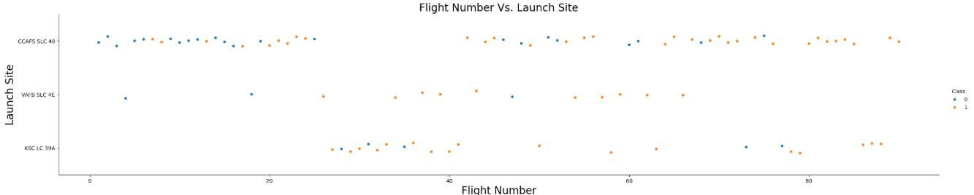
Flight Number vs Launch Site
Trend over time: Flight outcomes improve with higher flight numbers, highlighting modellable temporal learning effects.
01
Site distribution: Launch activity is concentrated at CCAFS SLC 40, with KSC LC 39A, and VAFB SLC 4E as secondary sites.
02
Predictive insight: Success rates (Class = 1) rise over time, suggesting launch site and flight sequence are strong candidate features for classification models.
03

Slide 19
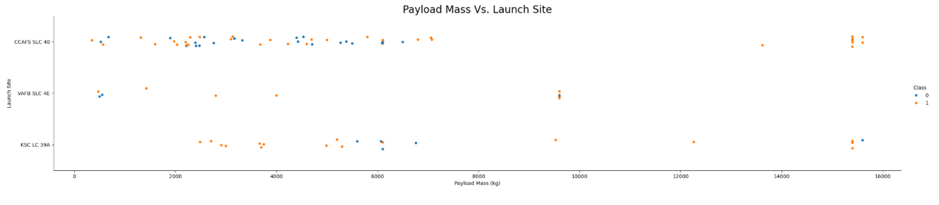
Payload vs Launch Site
Payload variation: Heavier payloads (up to 16,000kg) are observed at both CCAFS SLC 40 and KSC LC 39A, while VAFB SLC 4E is limited to lighter payloads (<10,000kg).
Success relationship: Across sites, higher payloads show mixed outcomes, but success is consistently present even at maximum payloads, this indicates system robustness.
Feature insight: Payload mass is a key variable but not the sole predictor of success.

Slide 20
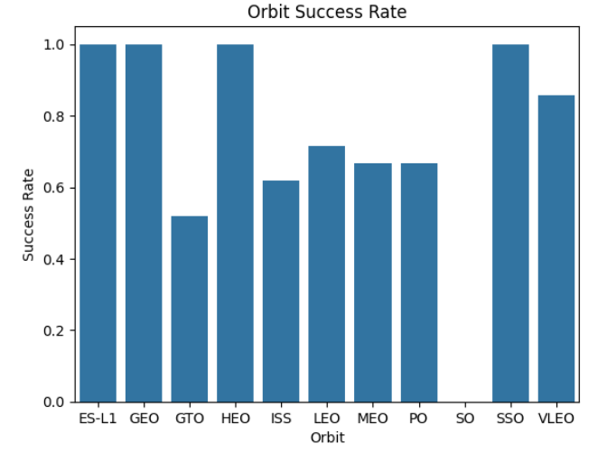
Success rate vs Orbit Type
The OS orbit has 0% success rate.
The ELS-1, GEO, HEO and SSO orbits have 100% success rate.
Orbits GTO, ISS, LEO, MEO and PO success rate is higher than 50% and less than 75%.

Slide 21
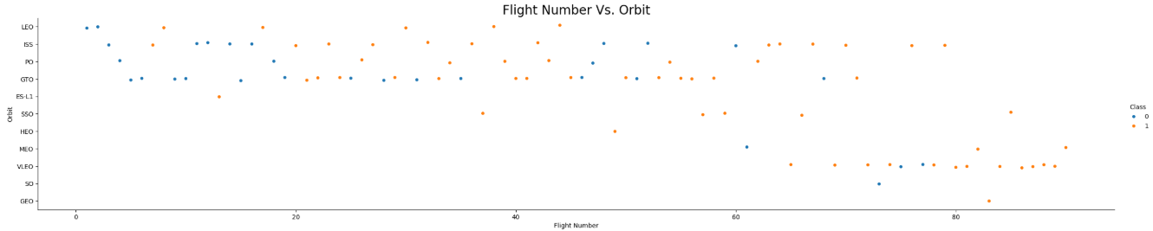
Flight Number vs Orbit Type
Early flights show more failures (blue dots) then later flights, this reflects the trial-and-error phase.
High success rates in later missions suggest technological maturity and improved reliability.
Success rate improves over time among all orbit types.

Slide 22

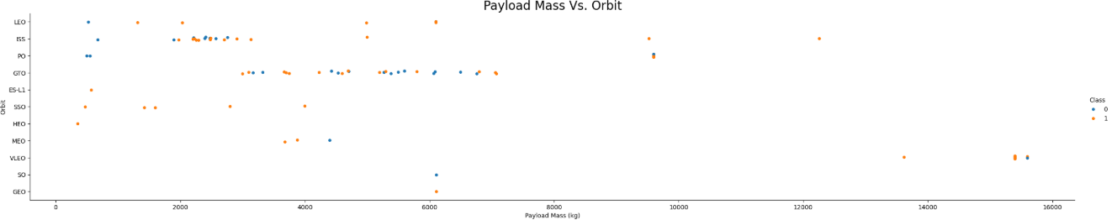
Payload vs Orbit Type
Only a few orbit types have payloads exceeding 10,000kg (ISS, PO, VLEO).
No correlation between orbit type and payload mass

Slide 23
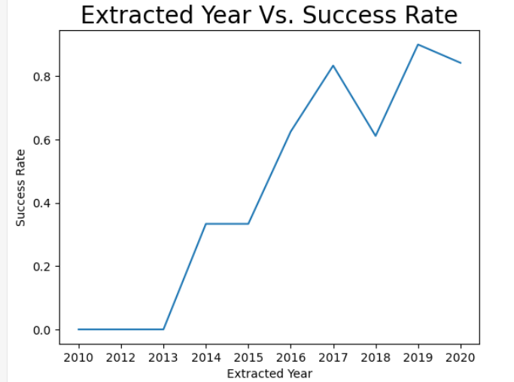
Launch Success Yearly Trend
Success rates were 0% up until 2013 where they began steadily increasing.
The success rate continuously increased from 2013 going from 0% and peaking at around 90% in 2019.
The year on year progression highlights how data-driven testing and development significantly improved mission reliability.

Slide 24
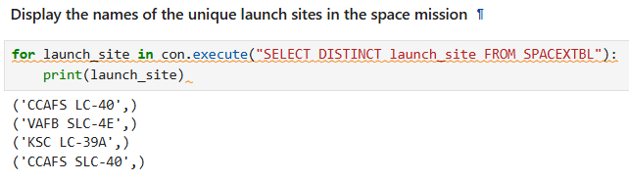
All Launch Site Names
The DISTINCT keyword ensures that only unique launch site names are returned.
This query helps us identify all the different launch locations used in the SpaceX missions dataset.
CCAFS SLC-40 → Cape Canveral Air Force Station Launch Complex 40
VAFB SLC-4E → Vandenberg Air Force Base Space Launch Complex 4E
KSC LC-39A → Kennedy Space Centre Launch Complex 39A

Slide 25
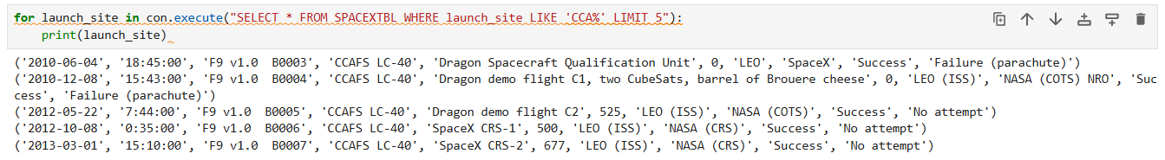
Launch site names beginning with ‘cca’
This query filters missions where the launch site starts with “CCA” (Cape Canveral) and shows the first five results.
The output lists early Falcon 9 launches from CCAFS LC-40 with details like payload mass, orbit, and mission outcome.
We can see that launches were not attempted or failed in these initial missions.

Slide 26
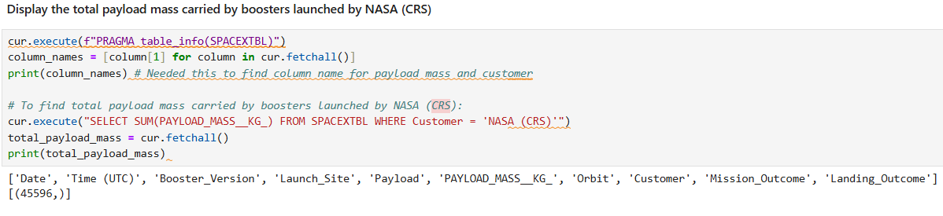
Total payload mass
This code calculates the total payload mass carried by SpaceX boosters for NASA (CRS) missions. It sends a SQL query to sum the payload_mass__kg_ column and filters only NASA (CRS) launches, it then retrieves the result and prints it. The database returned 45,596kg.

Slide 27
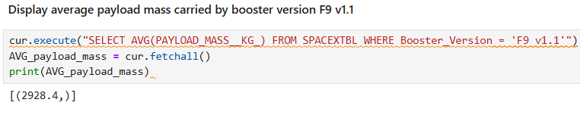
Average payload mass by f9 v1.1
This query calculates the average payload mass carried by the F9 v1.1 booster.
By looking only at launches with this booster version, the database computes the mean payload, which comes out to 2,928.4kg.
This represents the typical mass each F9 v1.1 carried into orbit.

Slide 28
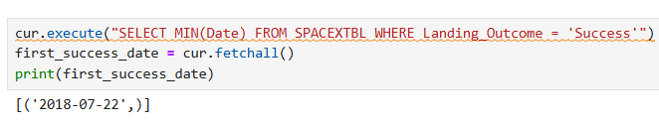
First successful ground landing date
This query finds the date of the very first successful SpaceX booster landing.
By checking only launches where the landing was successful, the database identifies July 22, 2018 as the milestone date for the company’s first landing achievement.

Slide 29
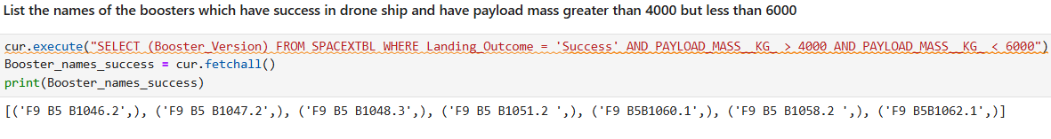
Successful drone ship landing with payload mass between 4000 and 6000
This query lists all booster versions that successfully landed while carrying a payload between 4,000kg and 6,000kg. The results show the specific boosters that achieved both a successful landing and a medium-weight payload.

Slide 30
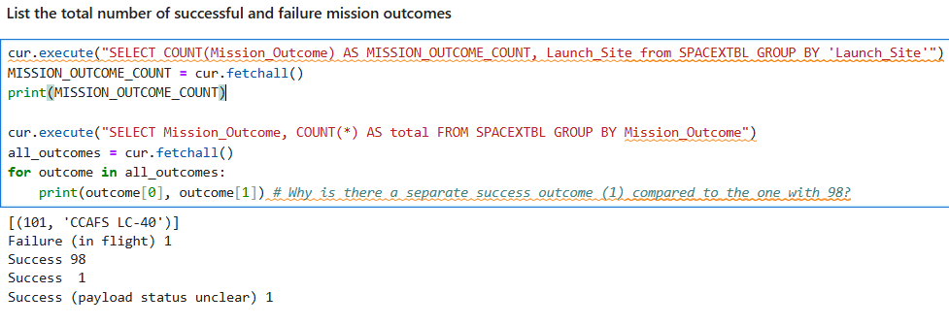
Total number of successful and failure mission outcomes
The first query counts how many missions were launched from each site, giving an idea of site activity.
The second query counts all missions by their outcome.
Out of all the launches, most were successful (98), with 1 failure and 1 status unclear.

Slide 31
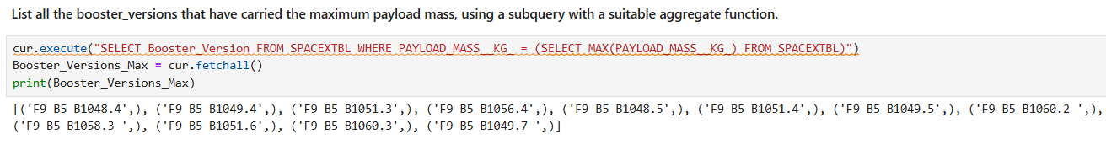
Boosters carried maximum load
This query listed all boosters carrying the maximum payload mass.
Results show that 12 rockets were launched carrying the maximum payload.

Slide 32
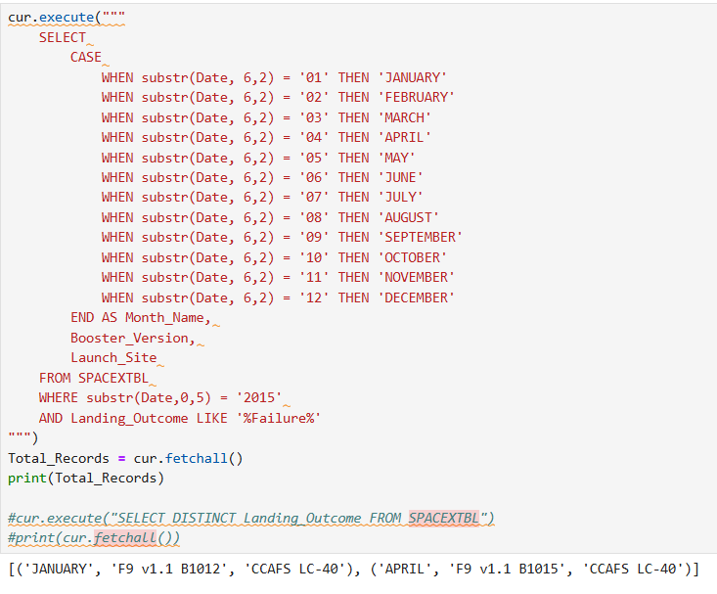
2015 launch records
This query lists all launches in 2015 where the boosters failed to land on the drone ship.
It shows the month of the launch, booster version, and the launch site. For example, in January 2015, booster F9 v1.1 B1012 from CCAFS LC-40 failed its landing.

Slide 33
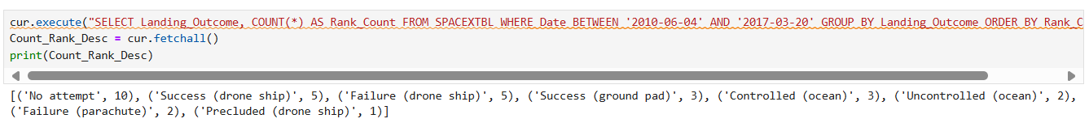
Rank landing outcomes between 2010-06-04 and 2017-03-20
Between June 2010 and March 2017, SpaceX recorded various landing outcomes, which can be ranked by frequency.
The most common outcome was ‘No attempt’ with ten occurrences.
Successful and failed drone ship landings both happened five times, while ground pad successes and controlled ocean landings were less frequent.
This ranking highlights the early challenges and progress in booster recovery efforts.

Slide 34
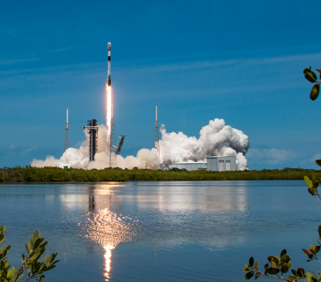

Launch sites proximities analysis

Slide 35
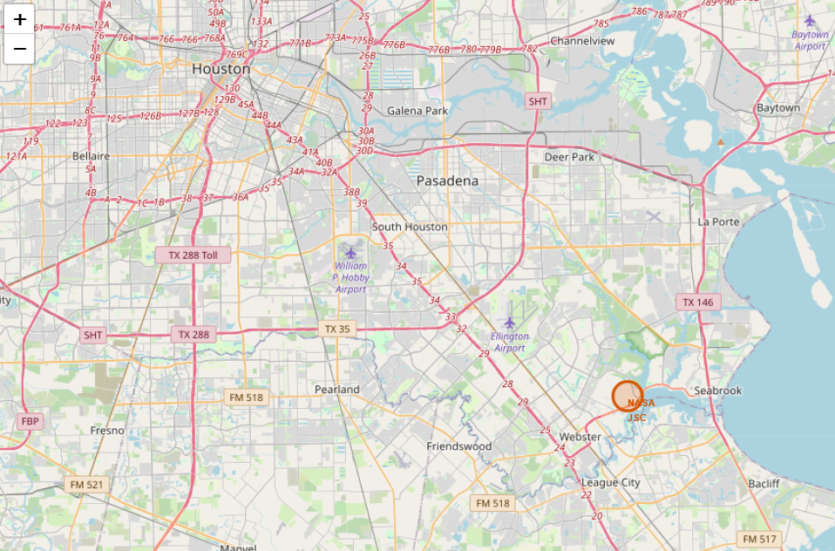
Marking the launch site
Folium was used to present interactive dashboards where the user can explore a map of the world and see each of the SpaceX launch sites such as the site shown here (Houston, Texas).
Folium lab: IBM-Data-Science/Course-10-Capstone-Project/lab_jupyter_launch_site_location.ipynb at main · Sion719/IBM-Data-Science

Slide 36
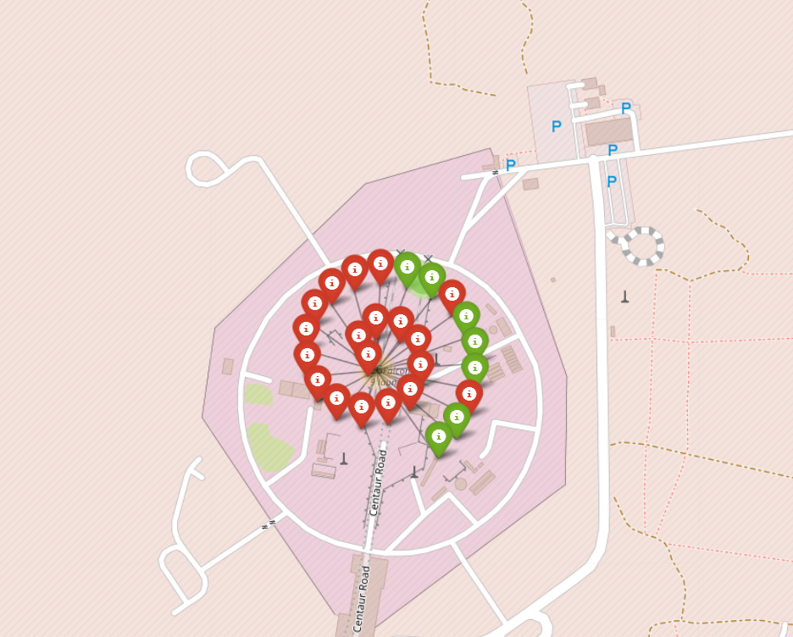
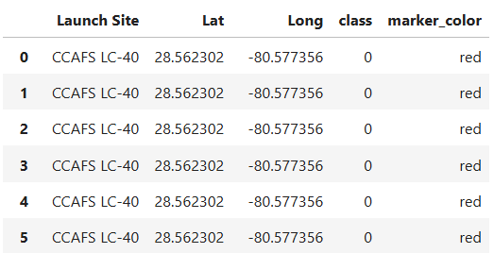
Marking the success/failed launches for each site
Green = Success
Red = Fail

Slide 37
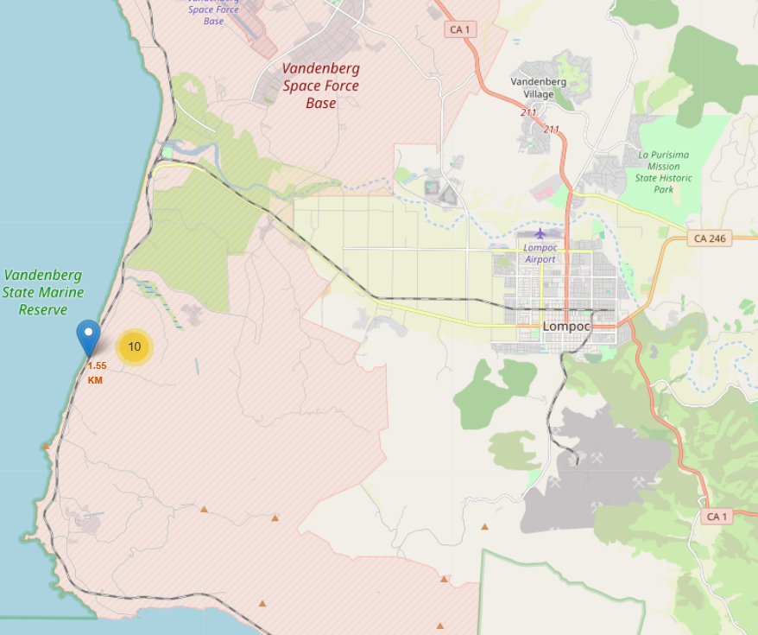
Calculating the distance from a launch site to its proximities
Folium was used so users can see what is in the proximity of different launch sites and the distance to them such as the distance to the coastline shown here.

Slide 38
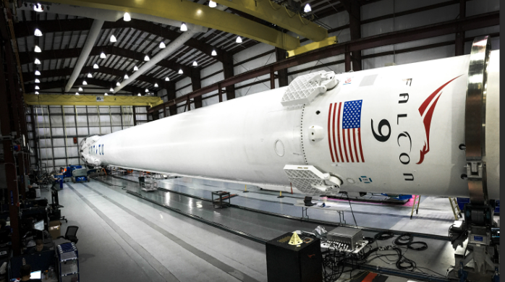
Building a dashboard with plotly

Slide 39
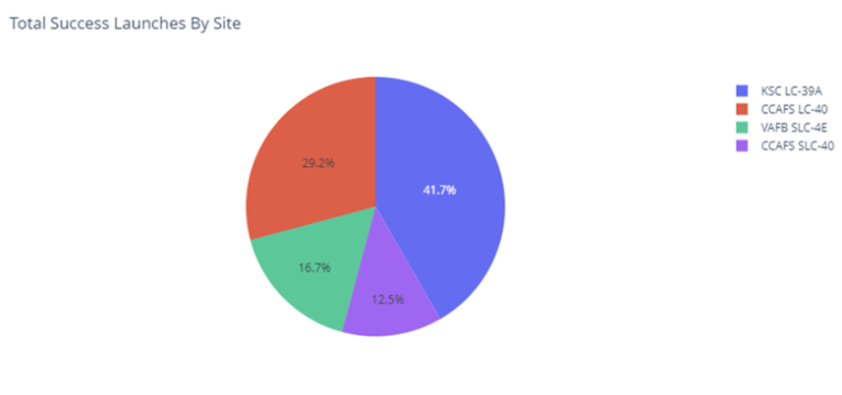
Total Launch success for each site
KSC LC-39A: 41.7% of successful launches
CCAFS LC-40: 29.2% of successful launches
VAFB SLC-4E: 16.7% of successful launches
CCAFS SLC-40: 12.5% of successful launches

Slide 40
Predictive analysis (classification)

Slide 41
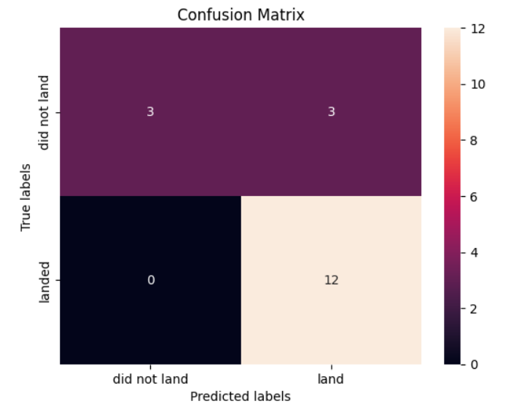
Confusion matrix
The confusion matrix suggests that the best performing model is the logistic regression model.
It predicts 12 true positives, 3 false positives, 3 true negative, and 0 false negatives.

Slide 42

conclusion
Rocket launch success rate significantly increased year by year
First successful ground landing date – July 22, 2018
12 rockets were launched carrying the maximum payload

Slide 43
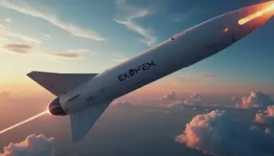
Thank you
GitHub: Sion719/IBM-Data-Science: This repository contains work submitted from the IBM Data Science Professional Certificate.

